Slide 1
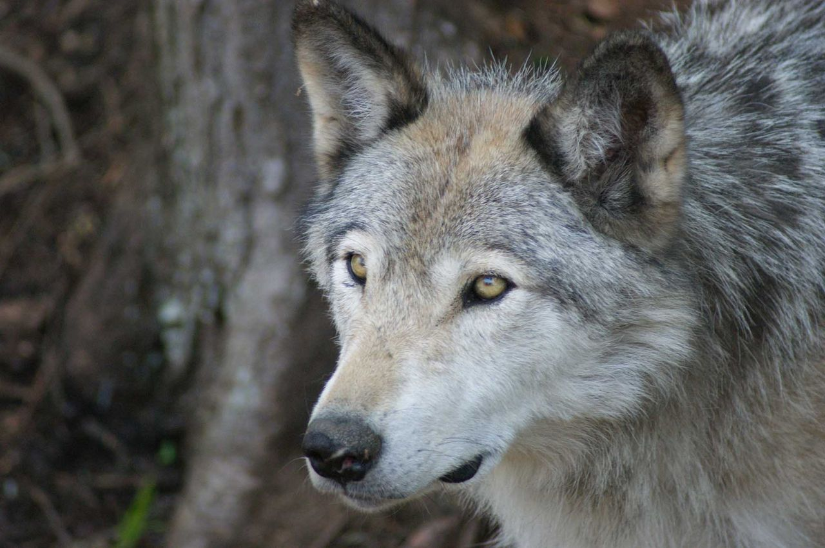
Understanding and analysing a single ordinary differential equation
Hanna ten Brink
29 September 2025

Slide 2
Lecture goals
After this lecture you can:
Formulate a 1dim ODE model
Calculate equilibria for a 1dim ODE model
Determine the stability and dynamics of 1dim ODE models using graphical analysis
Notes:
Why are we doing this by hand while there are computers / while we will work with models that are far too complicated?
Important to get an understanding of what equilibria are/ how they work/ how they appear/disappear. Additionally, e.g. logistic growth also used in more complicated models, so important to understand these types of functions that are often used.

Slide 3
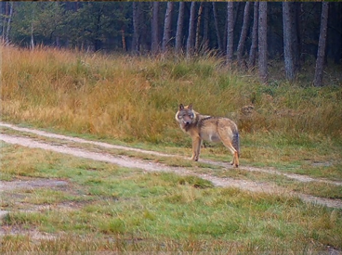
Modelling wolves on the Ginkelse Heide
Notes:
Since 2015 wolves (Canis lupus) have returned to the Netherlands, and a population now lives near Hotel de Bosrand on the Ginkelse heide. We want to formulate the differential equation for the dynamics of the population density of female wolves W(t) (individuals per hectare) on the Ginkelse heide.

Slide 4
Modelling wolves on the Ginkelse Heide
We want to formulate the differential equation for the dynamics of the population density of female wolves W(t) (individuals per hectare) on the Ginkelse heide.
Step 1: Births only
Step 2: Mortality due to car collisions
Step 3: Intraspecific competition

Slide 5
Baseline wolf dynamics: Births only
Each wolf has a baseline per-capita birth rate b (per day). Ignoring pack structure and other complications, formulate a differential equation describing the population dynamics of wolves.
Notes:
Per capita = per individual
To get the total birth rate, you need to multiply with the population density

Slide 6
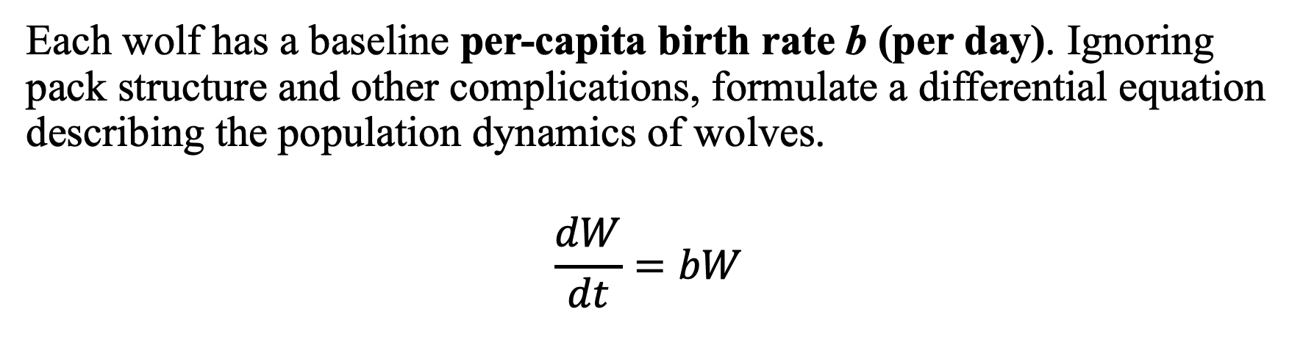
Baseline wolf dynamics: Births only
Each wolf has a baseline per-capita birth rate b (per day). Ignoring pack structure and other complications, formulate a differential equation describing the population dynamics of wolves.
$$\frac{dW}{dt}=bW$$

Slide 7
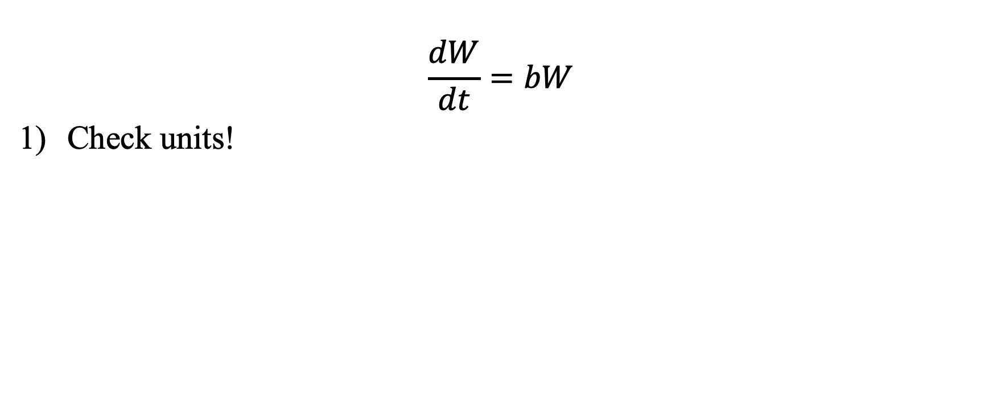
Baseline wolf dynamics: Births only
$$\frac{dW}{dt}=bW$$
Check units!

Slide 8
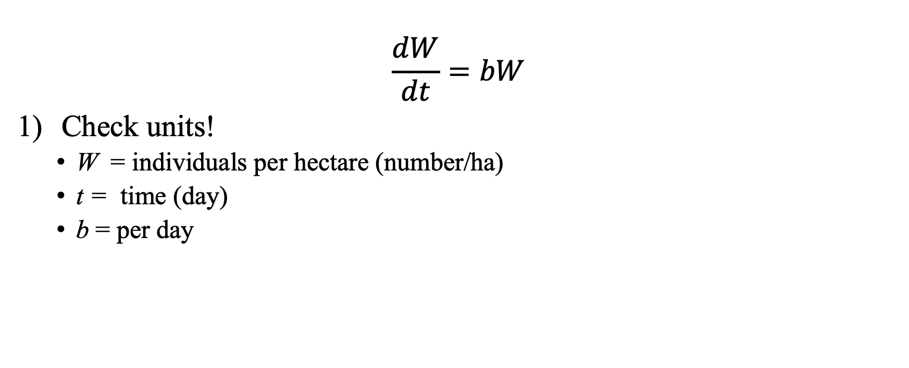
Baseline wolf dynamics: Births only
$$\frac{dW}{dt}=bW$$
Check units!
W = individuals per hectare (number/ha)
t = time (day)
b = per day
Individuals per hectare per day (#/(ha day))
Individuals per hectare per day (#/(ha day))

Slide 9

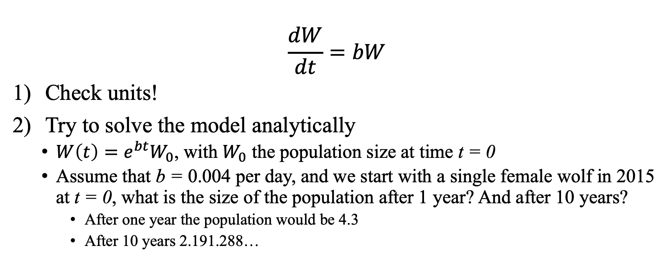
Baseline wolf dynamics: Births only
$$\frac{dW}{dt}=bW$$
Check units!
Try to solve the model analytically
$W\left(t\right)=e^{bt}W_{0}$, with $W_{0}$ the population size at time t = 0
Assume that b = 0.004 per day, and we start with a single female wolf in 2015 at t = 0, what is the size of the population after 1 year? And after 10 years?
After one year the population would be 4.3
After 10 years 2.191.288…

Slide 10
Baseline wolf dynamics: Births only
$$\frac{dW}{dt}=bW$$
Check units!
Try to solve the model analytically
$W\left(t\right)=e^{bt}W_{0}$, with $W_{0}$ the population size at time t = 0
Assume that b = 0.004 per day, and we start with a single female wolf in 2015 at t = 0, what is the size of the population after 1 year? And after 10 years?
After one year the population would be 4.3
After 10 years 2.191.288…

Slide 11
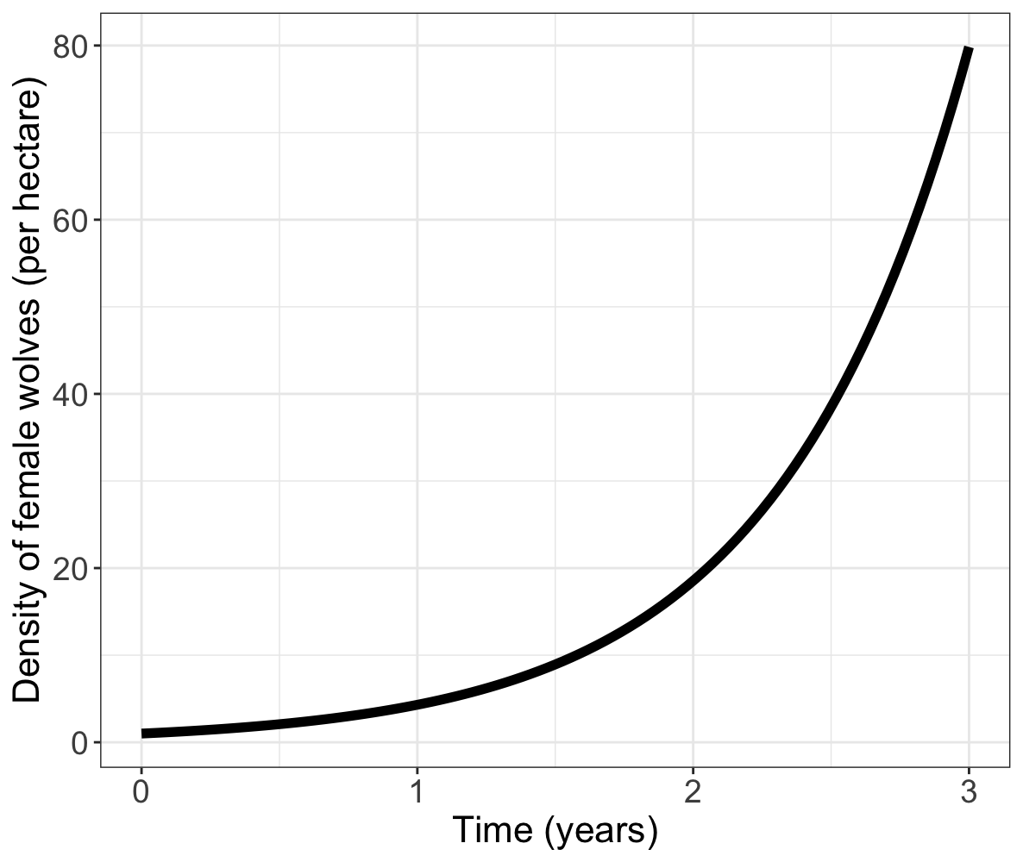
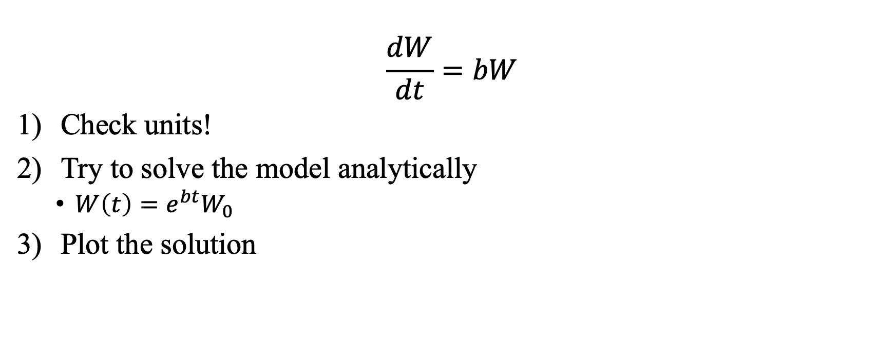
Baseline wolf dynamics: Births only
$$\frac{dW}{dt}=bW$$
Check units!
Try to solve the model analytically
$W\left(t\right)=e^{bt}W_{0}$
Plot the solution

Slide 12
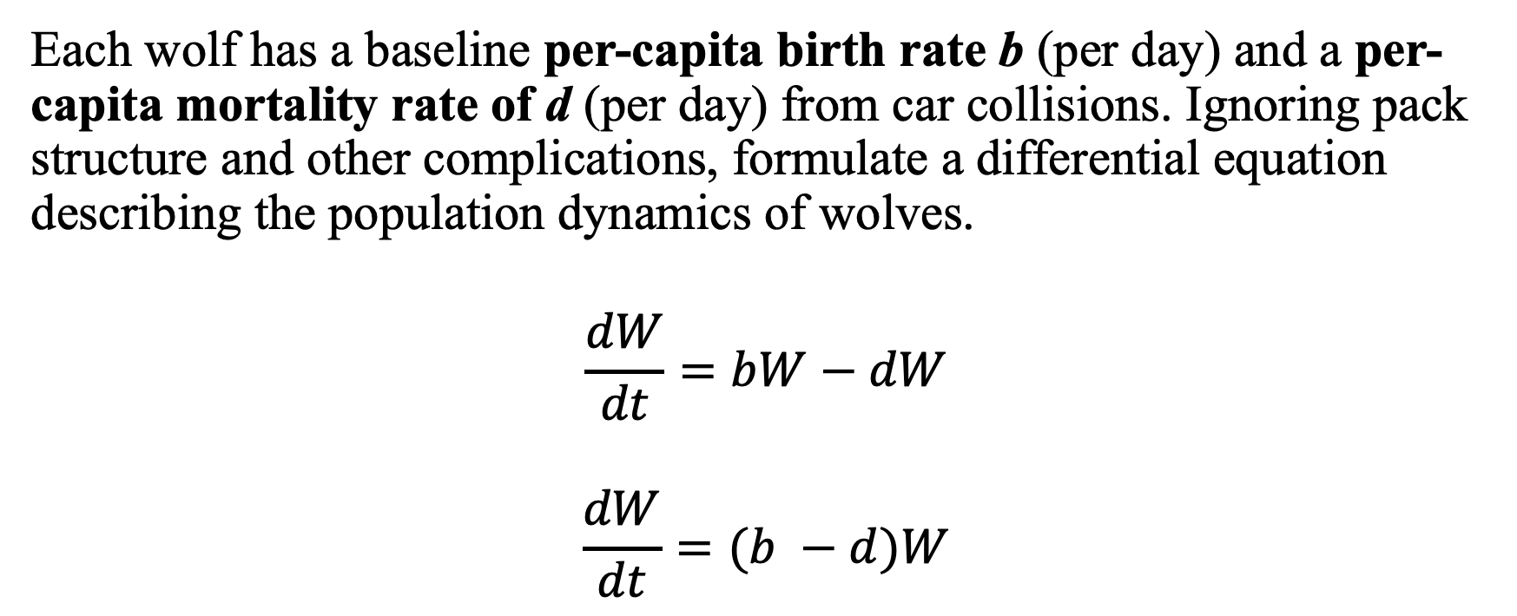
Extending the model with mortality
Each wolf has a baseline per-capita birth rate b (per day) and a per-capita mortality rate of d (per day) from car collisions. Ignoring pack structure and other complications, formulate a differential equation describing the population dynamics of wolves.
$$\frac{dW}{dt}=bW−dW$$
$$\frac{dW}{dt}=(b −d)W$$
Notes:
Wolves in the NL mostly die due to incidents with cars!
Alternatively, include the car density in the model:
dW/dt = c*W – d*m*c*W

Slide 13
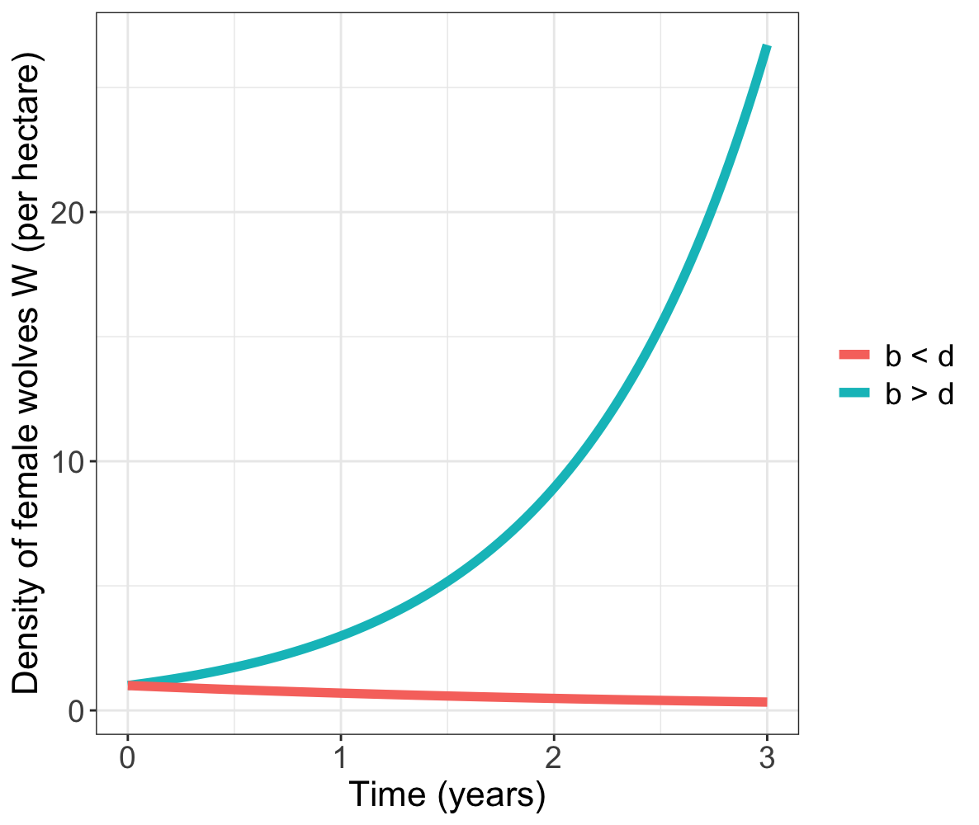
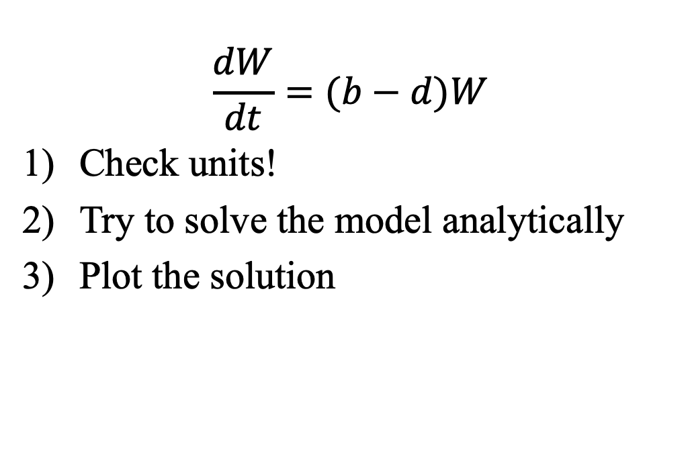
Extending the model with mortality
$$\frac{dW}{dt}=(b−d)W$$
Check units!
Try to solve the model analytically
Plot the solution
Notes:
In case of the alternative model with car density
Dw/dt = b*W - d*m*c*W
m = Ha/day
c = cars/Ha
m*c*W = #/day
d = 1/car

Slide 14
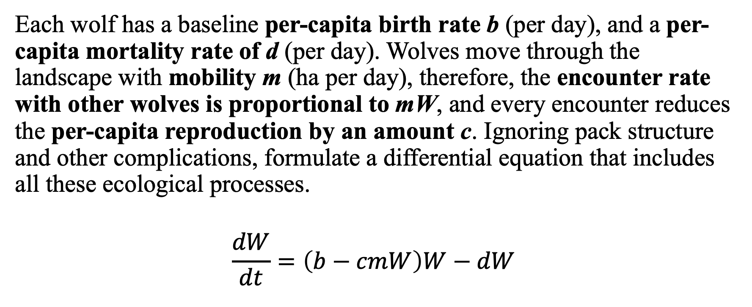
Extending the model with competition
Each wolf has a baseline per-capita birth rate b (per day), and a per-capita mortality rate of d (per day). Wolves move through the landscape with mobility m (ha per day), therefore, the encounter rate with other wolves is proportional to mW, and every encounter reduces the per-capita reproduction by an amount c. Ignoring pack structure and other complications, formulate a differential equation that includes all these ecological processes.
$$\frac{dW}{dt}=\left(b−cmW\right)W−dW$$
Notes:
In the Netherlands, wolves do not compete with other top predators such as bears, and mainly experience intraspecific competition for territories, which negatively effects birth rate.

Slide 15
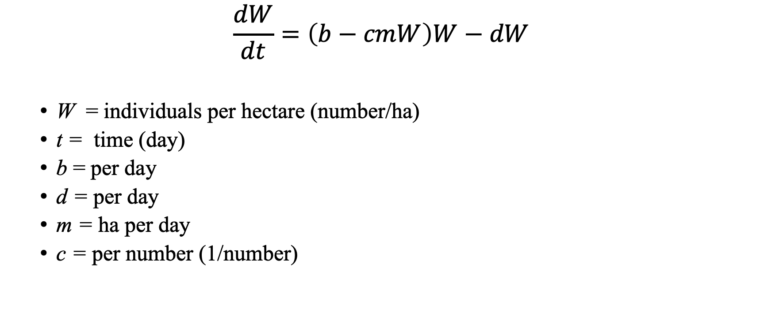
Check the units
$$\frac{dW}{dt}=\left(b−cmW\right)W−dW$$
W = individuals per hectare (number/ha)
t = time (day)
b = per day
d = per day
m = ha per day
c = per number (1/number)
Individuals per hectare per day (#/(ha day))
per day
Individuals per hectare per day (#/(ha day))
Individuals per hectare per day (#/(ha day))
Notes:
Explanation of c: the negative effect per wolf encounter.

Slide 16
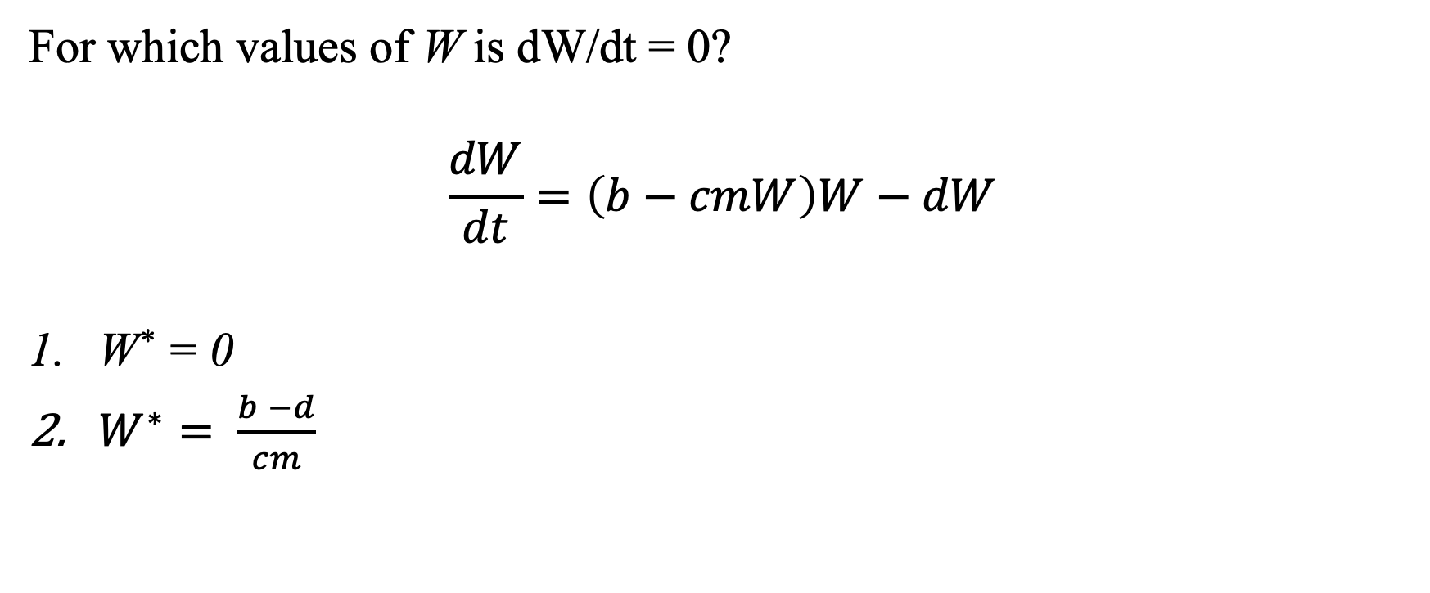
Model analysis: find the equilibria
For which values of W is dW/dt = 0?
$$\frac{dW}{dt}=\left(b−cmW\right)W−dW$$
W* = 0
$W^{∗}= \frac{b −d}{cm}$

Slide 17
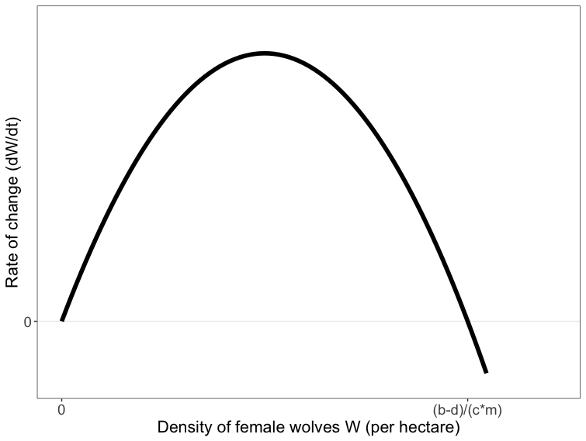
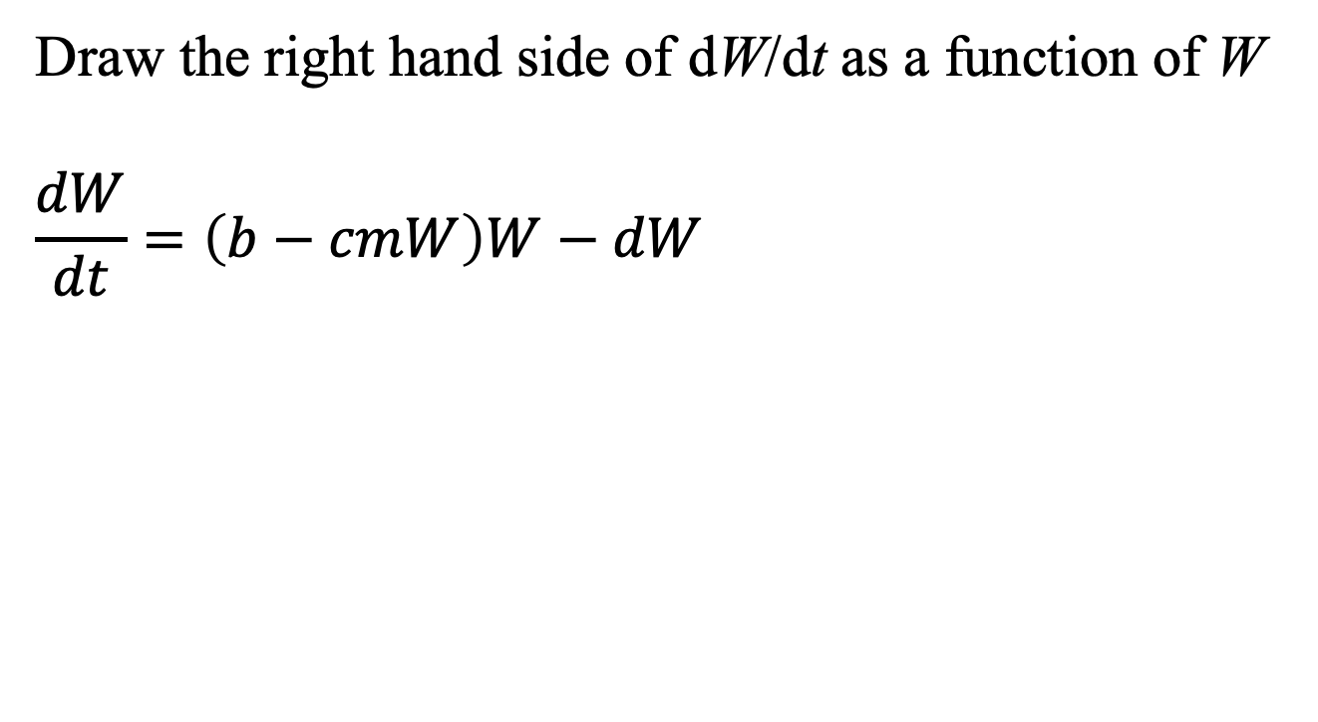
Model analysis: graphical analysis
Draw the right hand side of dW/dt as a function of W
$$\frac{dW}{dt}=\left(b−cmW\right)W−dW$$

Slide 18
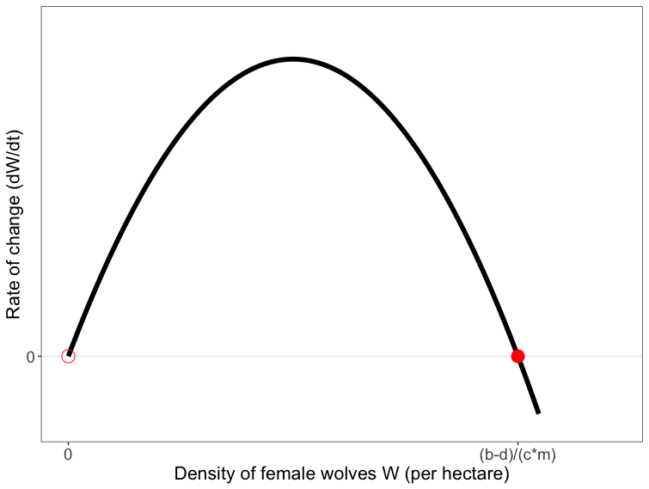
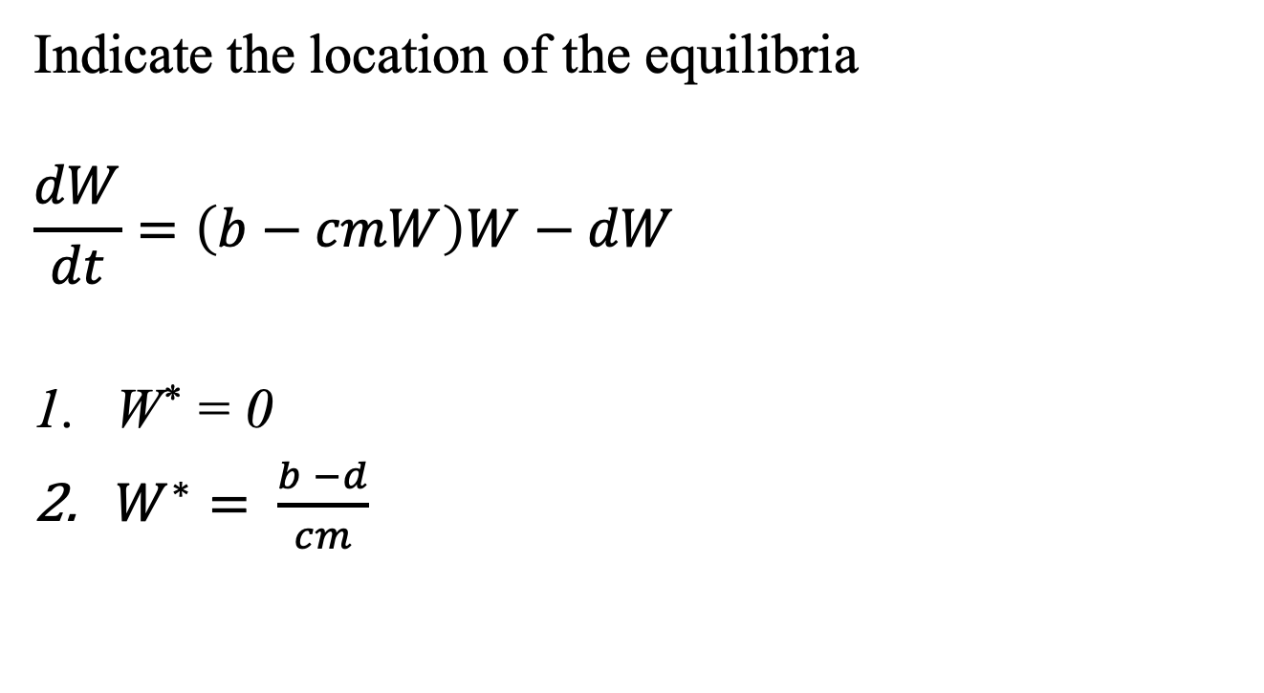
Model analysis: graphical analysis
Indicate the location of the equilibria
$$\frac{dW}{dt}=\left(b−cmW\right)W−dW$$
W* = 0
$W^{∗}= \frac{b −d}{cm}$

Slide 19
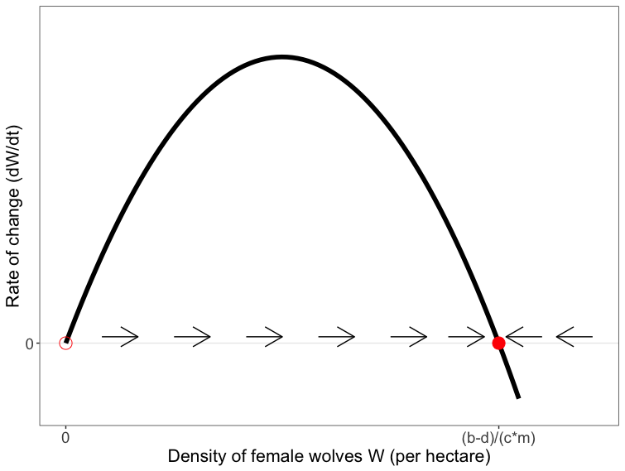
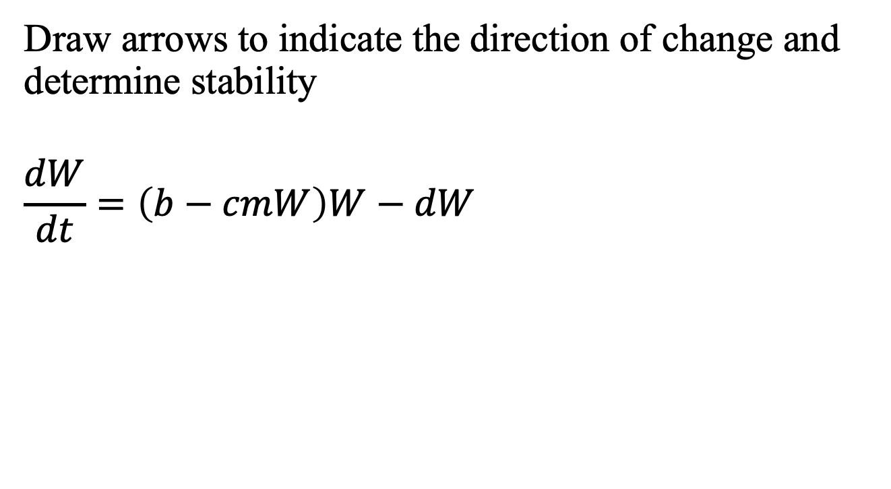
Model analysis: graphical analysis
Draw arrows to indicate the direction of change and determine stability
$$\frac{dW}{dt}=\left(b−cmW\right)W−dW$$

Slide 20
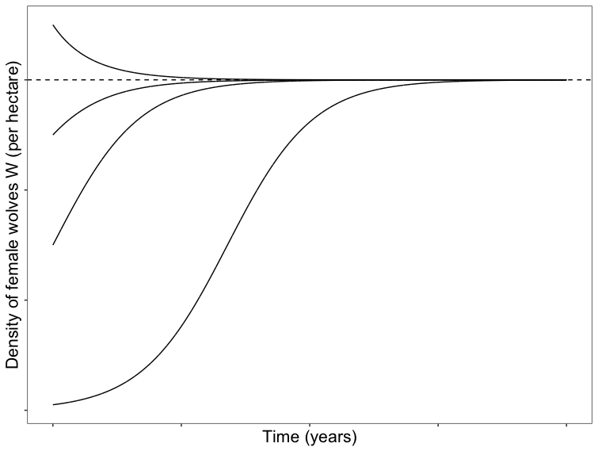
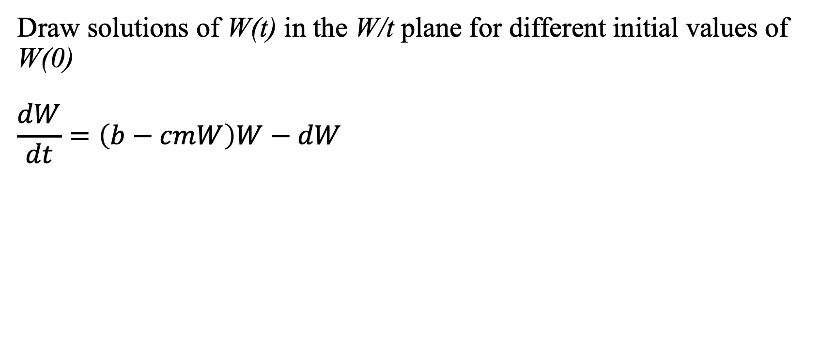
Model analysis: graphical analysis
Draw solutions of W(t) in the W/t plane for different initial values of W(0)
$$\frac{dW}{dt}=\left(b−cmW\right)W−dW$$

Slide 21
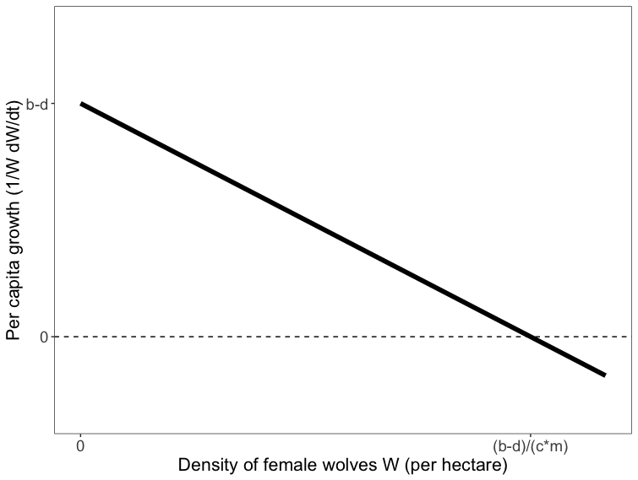
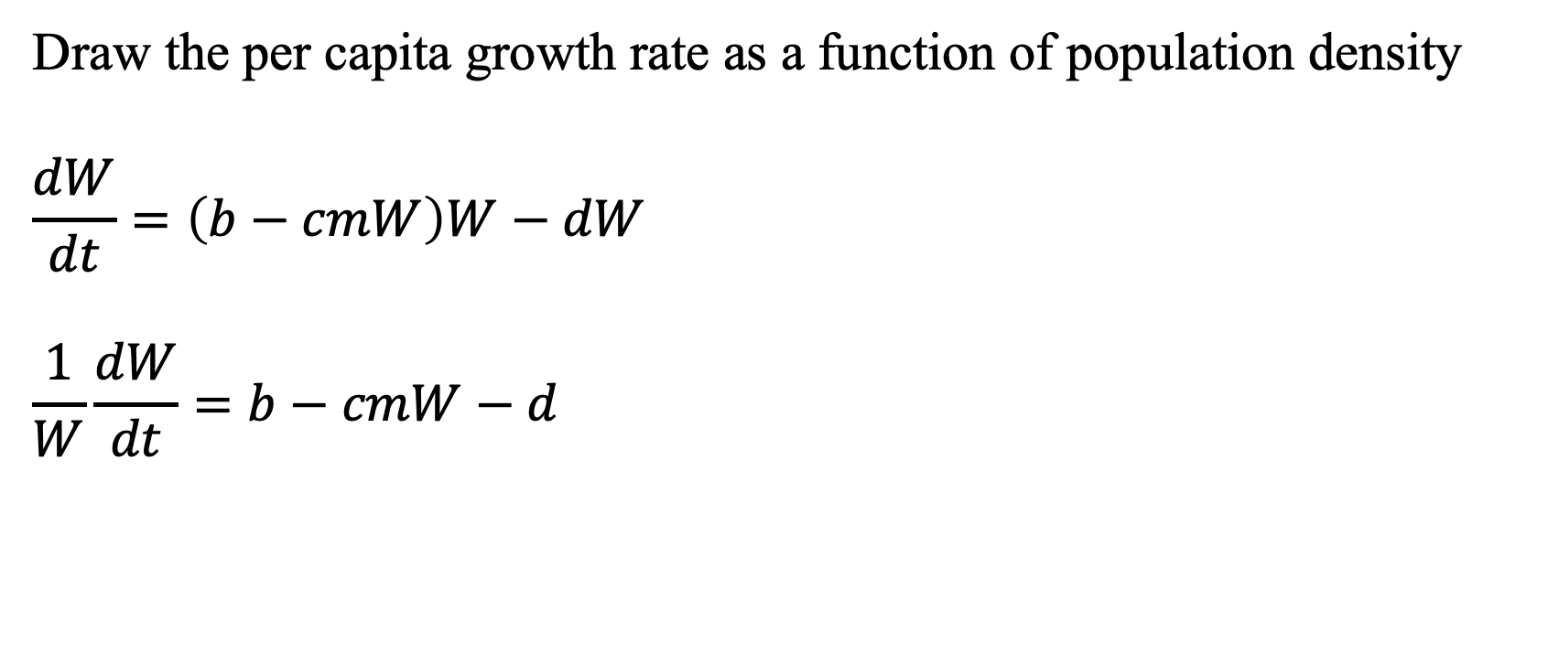
Model analysis: graphical analysis
Draw the per capita growth rate as a function of population density
$$\frac{dW}{dt}=\left(b−cmW\right)W−dW$$
$$\frac{1}{W}\frac{dW}{dt}=b−cmW−d$$
Notes:
This step is mostly to improve your own understanding of the model

Slide 22
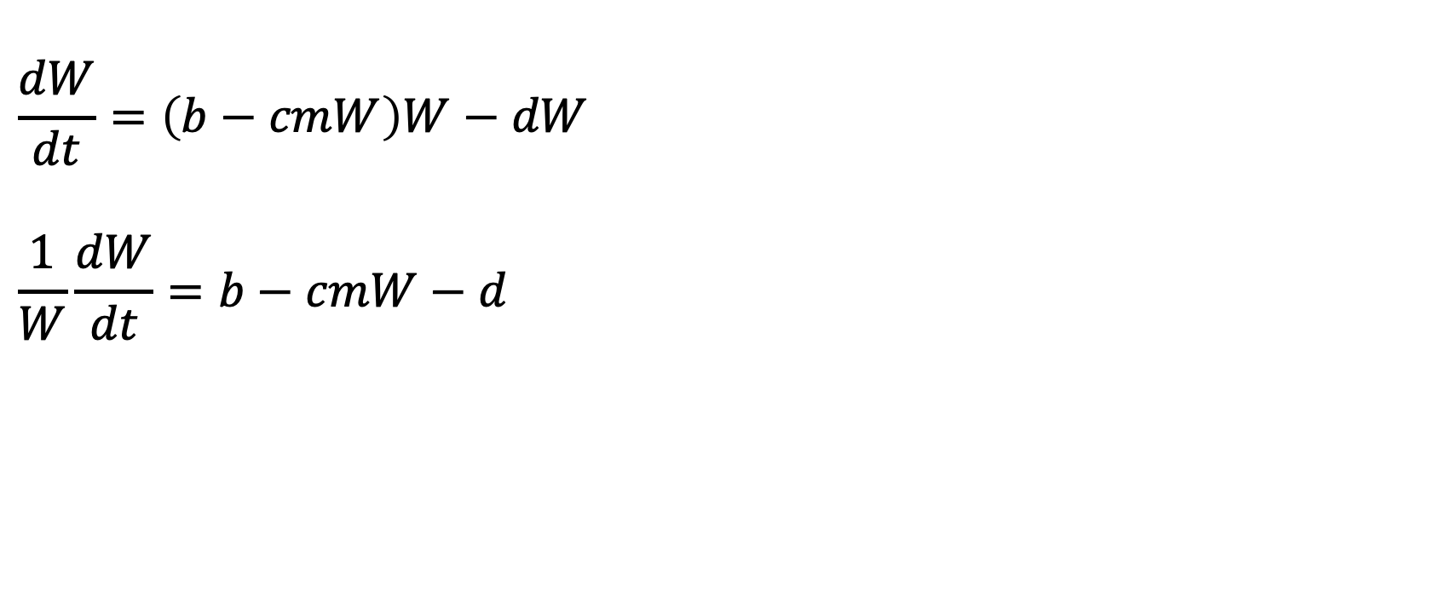
Model interpretation: which terms are density dependent?
$$\frac{dW}{dt}=\left(b−cmW\right)W−dW$$
$$\frac{1}{W}\frac{dW}{dt}=b−cmW−d$$
Notes:
B is density-independent, it doesn’t change for individuals depending on density
But cm is desnity dependent, the decrease in the birth rate becomes higher when density is high

Slide 23
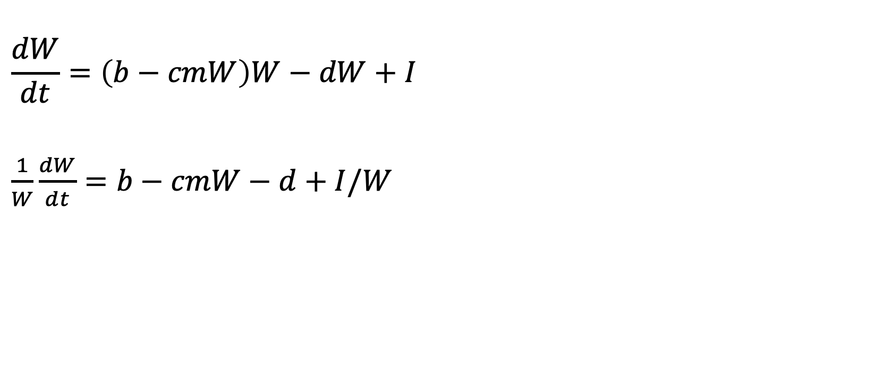
Model interpretation: which terms are density dependent?
$$\frac{dW}{dt}=\left(b−cmW\right)W−dW+I$$
$\frac{1}{W}\frac{dW}{dt}=b−cmW−d+I/W$
Notes:
Even though I is independent of W, it represents a density-dependent rate, since the impact per individual decreases at higher density!

Slide 24
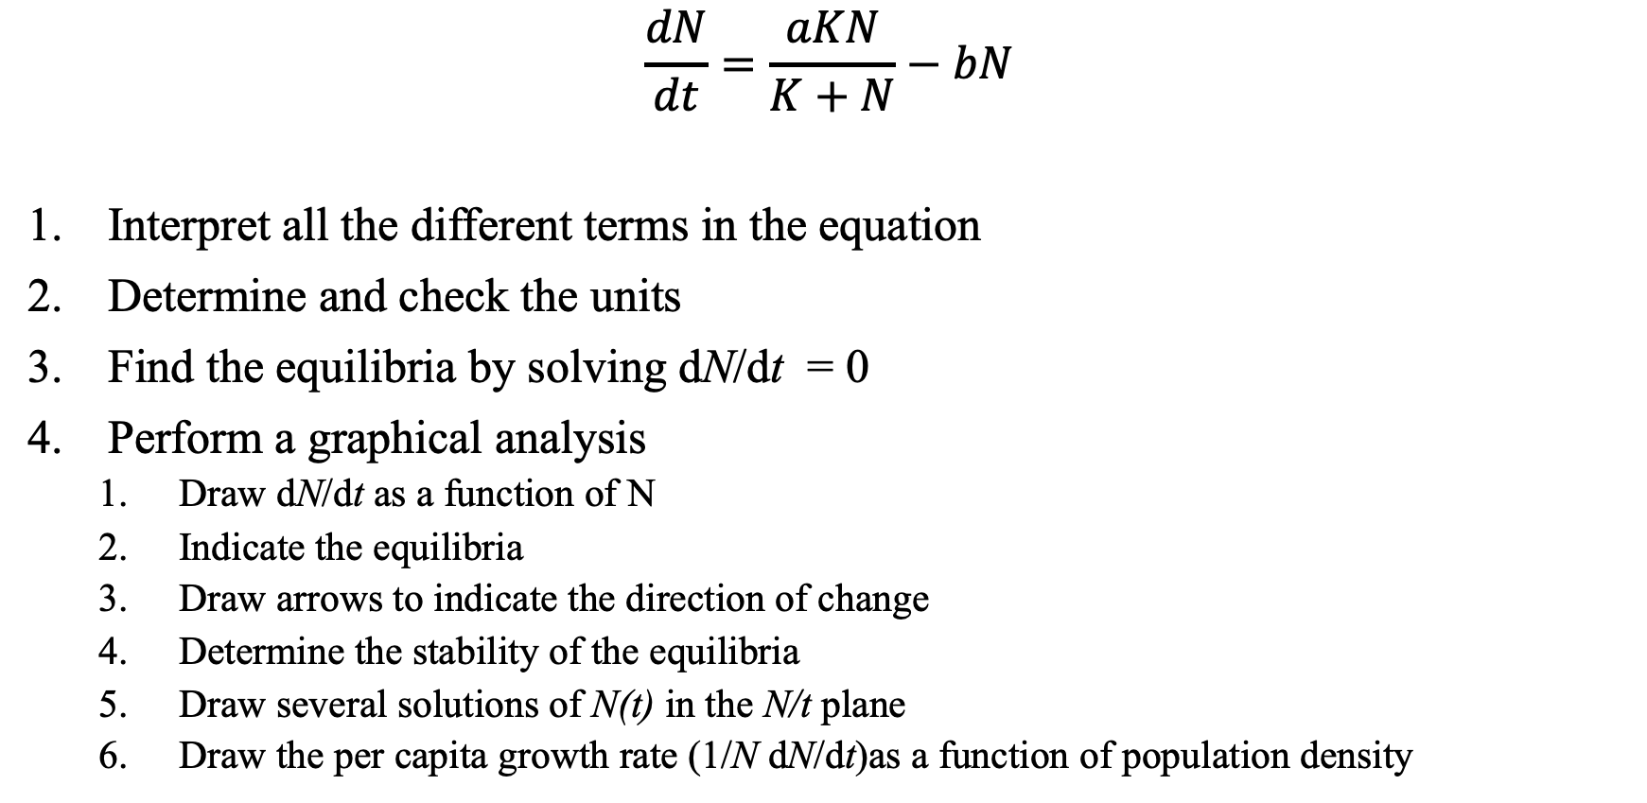
Practice
$$\frac{dN}{dt}=\frac{aKN}{K+N}−bN$$
Interpret all the different terms in the equation
Determine and check the units
Find the equilibria by solving dN/dt = 0
Perform a graphical analysis
Draw dN/dt as a function of N
Indicate the equilibria
Draw arrows to indicate the direction of change
Determine the stability of the equilibria
Draw several solutions of N(t) in the N/t plane
Draw the per capita growth rate (1/N dN/dt)as a function of population density
Notes:
Practice together

Slide 25
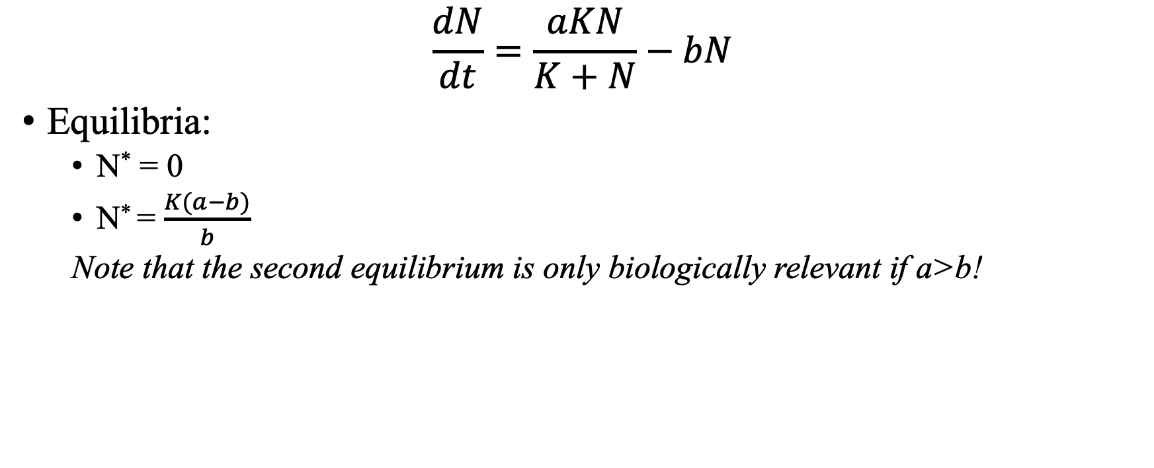
Solution
$$\frac{dN}{dt}=\frac{aKN}{K+N}−bN$$
Equilibria:
N* = 0
N* = $\frac{K(a−b)}{b}$
Note that the second equilibrium is only biologically relevant if a>b!

Slide 26
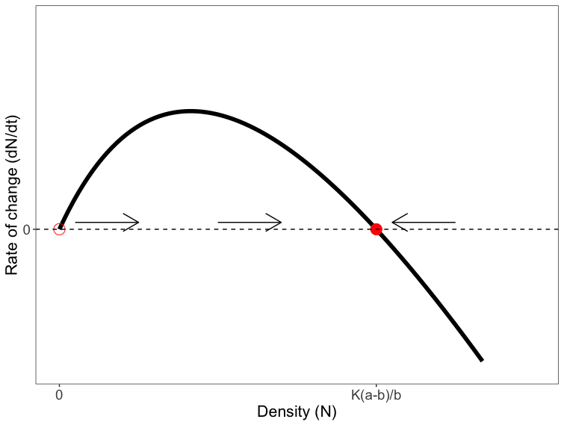
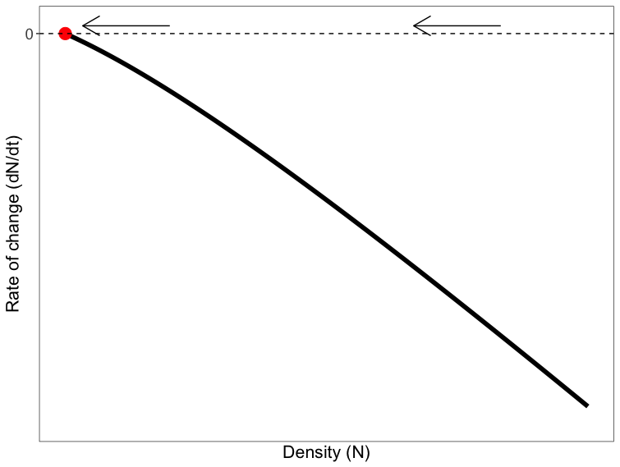
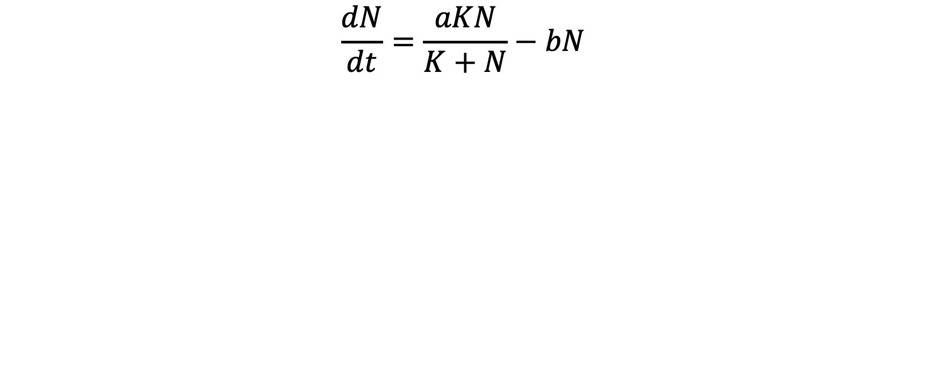
Solution
$$\frac{dN}{dt}=\frac{aKN}{K+N}−bN$$
If a>b
If a<b

Slide 27
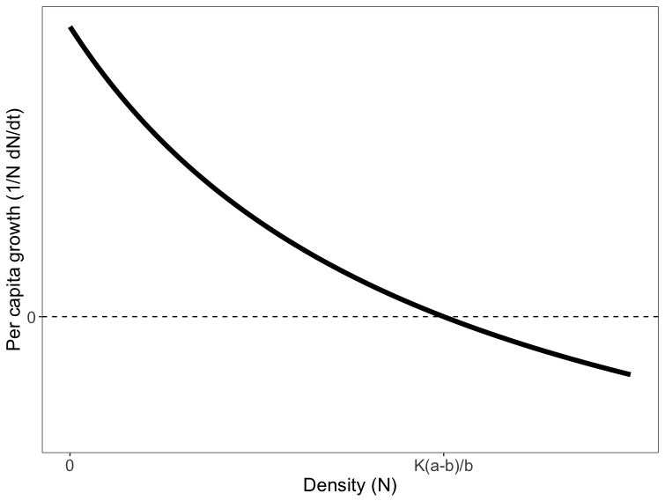
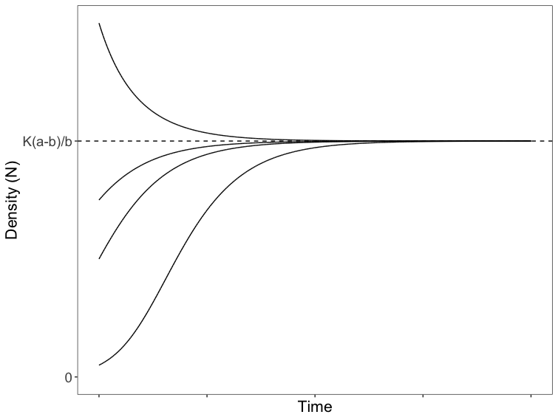
Solution
$$\frac{dN}{dt}=\frac{aKN}{K+N}−bN$$
Assuming a > b

Slide 28
Practice
For each of the models on the whiteboard, do the following
Interpret all the different terms in the equation
Determine and check the units
Find the equilibria by solving dN/dt = 0
Perform a graphical analysis
Draw dN/dt as a function of N
Indicate the equilibria
Draw arrows to indicate the direction of change
Determine the stability of the equilibria
Draw several solutions of N(t) in the N/t plane
Draw the per capita growth rate (1/N dN/dt) as a function of population density

Slide 29
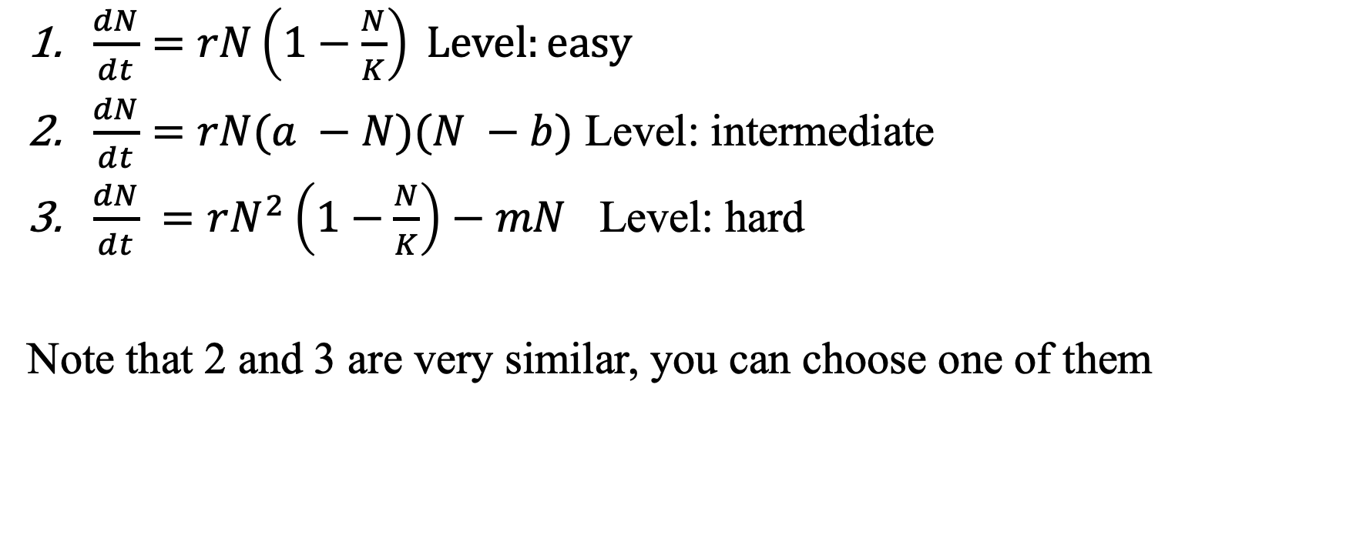
Equations to practice with
$\frac{dN}{dt}=rN\left(1−\frac{N}{K}\right) Level:easy$
$\frac{dN}{dt}=rN(a −N)(N −b)$ Level: intermediate
$\frac{dN}{dt} =rN^{2}\left(1−\frac{N}{K}\right)−mN$ Level: hard
Note that 2 and 3 are very similar, you can choose one of them

Slide 30
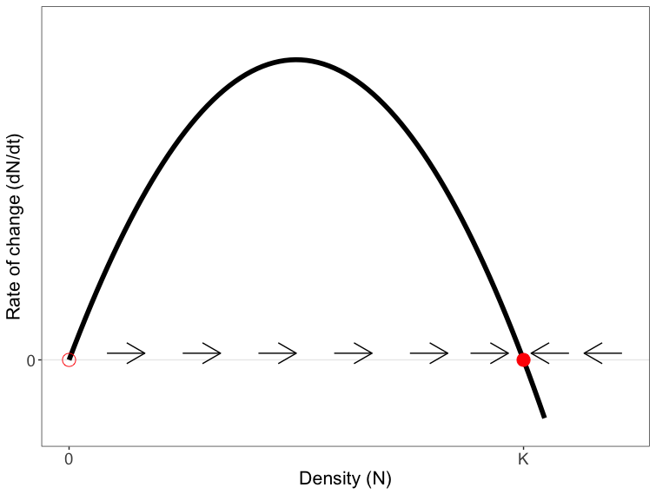
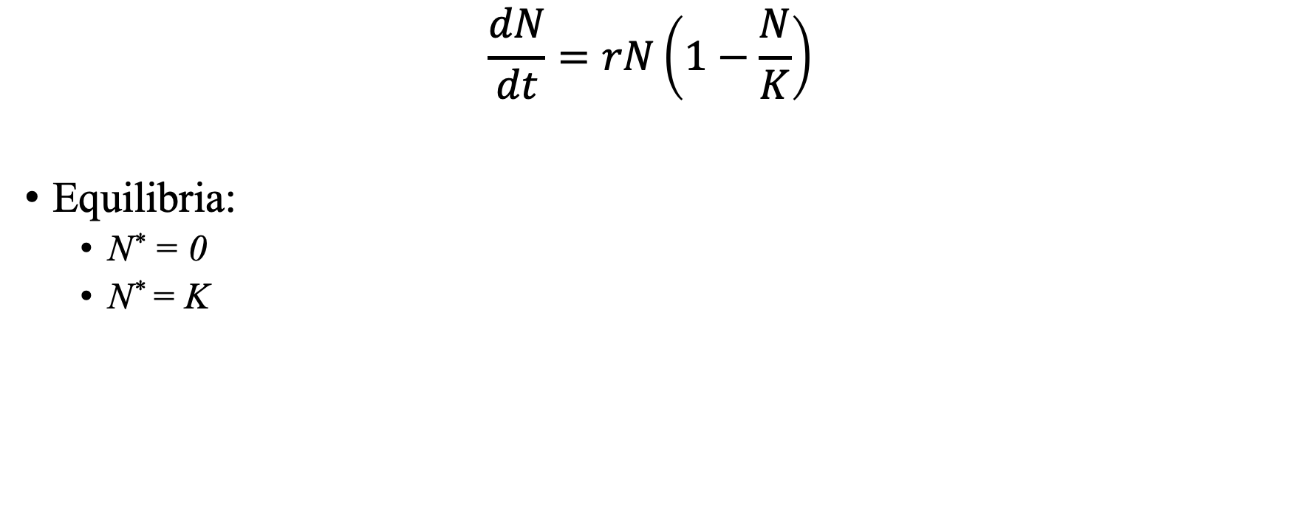
Solutions model 1: Logistic growth
$$\frac{dN}{dt}=rN\left(1−\frac{N}{K}\right)$$
Equilibria:
N* = 0
N* = K

Slide 31
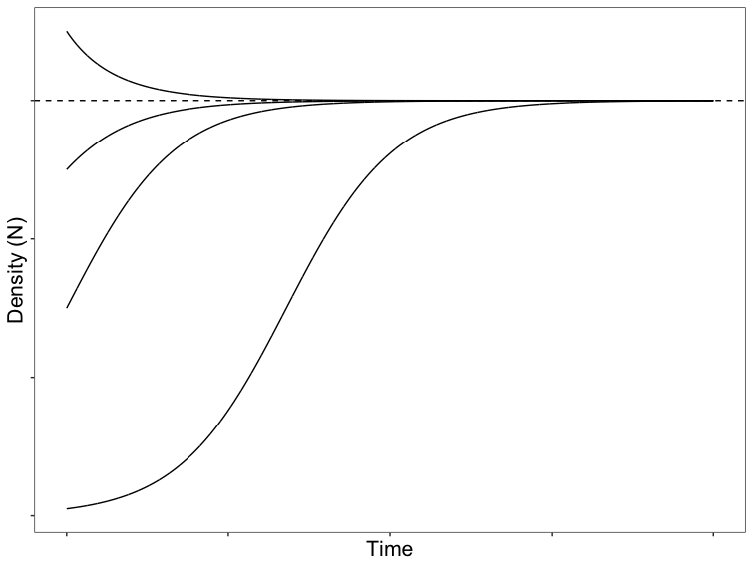
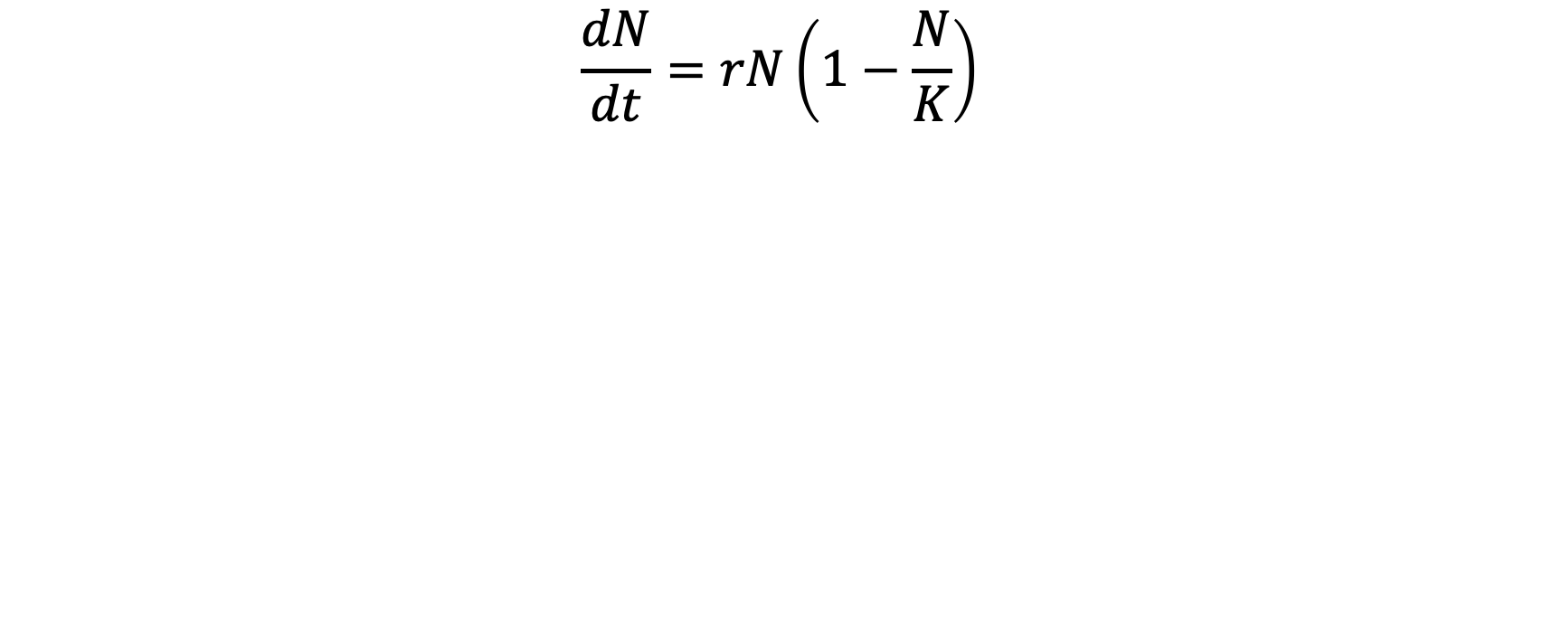
Solutions model 1: Logistic growth
$$\frac{dN}{dt}=rN\left(1−\frac{N}{K}\right)$$

Slide 32
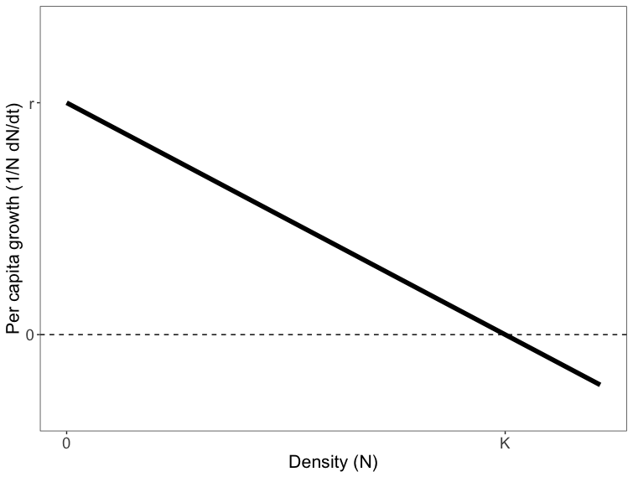
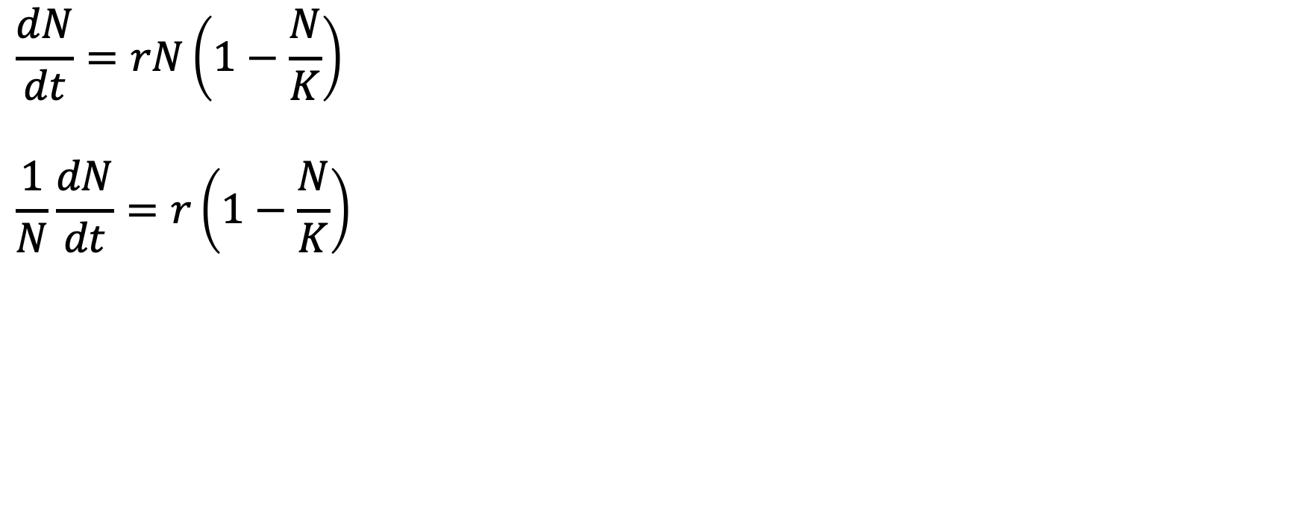
Solutions model 1: Logistic growth
$$\frac{dN}{dt}=rN\left(1−\frac{N}{K}\right)$$
$$\frac{1}{N}\frac{dN}{dt}=r\left(1−\frac{N}{K}\right)$$

Slide 33
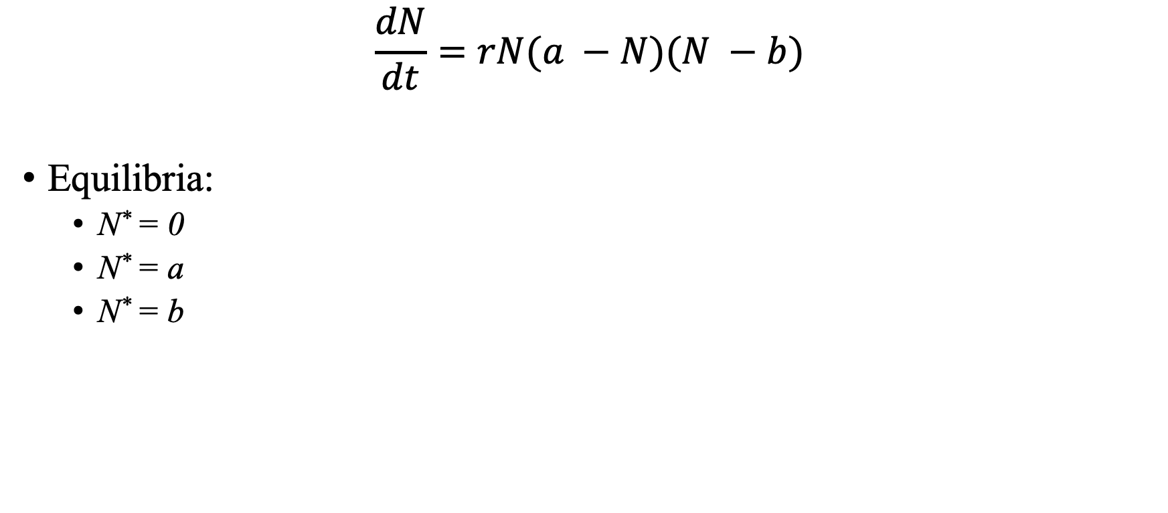
Solutions model 2: Allee effect
$$\frac{dN}{dt}=rN(a −N)(N −b)$$
Equilibria:
N* = 0
N* = a
N* = b
Notes:
(a-b)N – N^2 – ab
R(a-b)N^2 – rN^3 –abN
If N is close to zero negative
If N is very large, negative

Slide 34
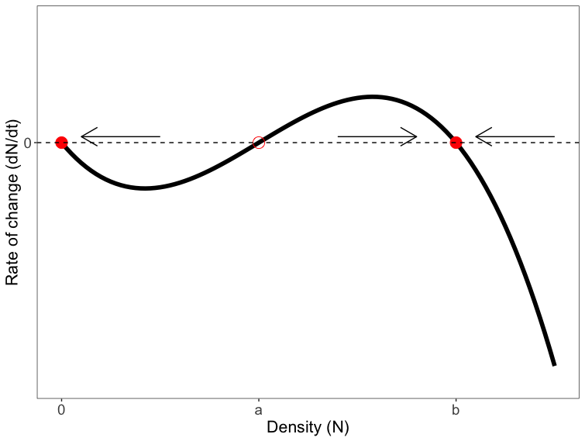

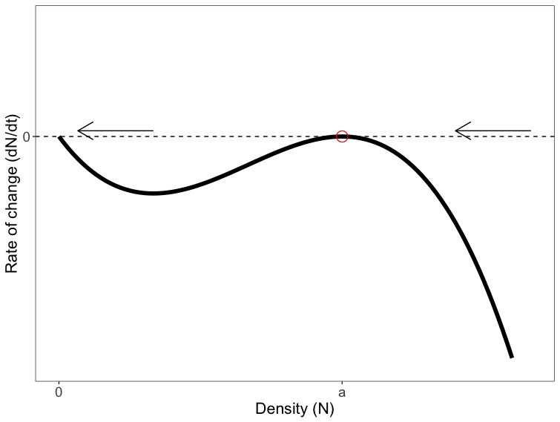
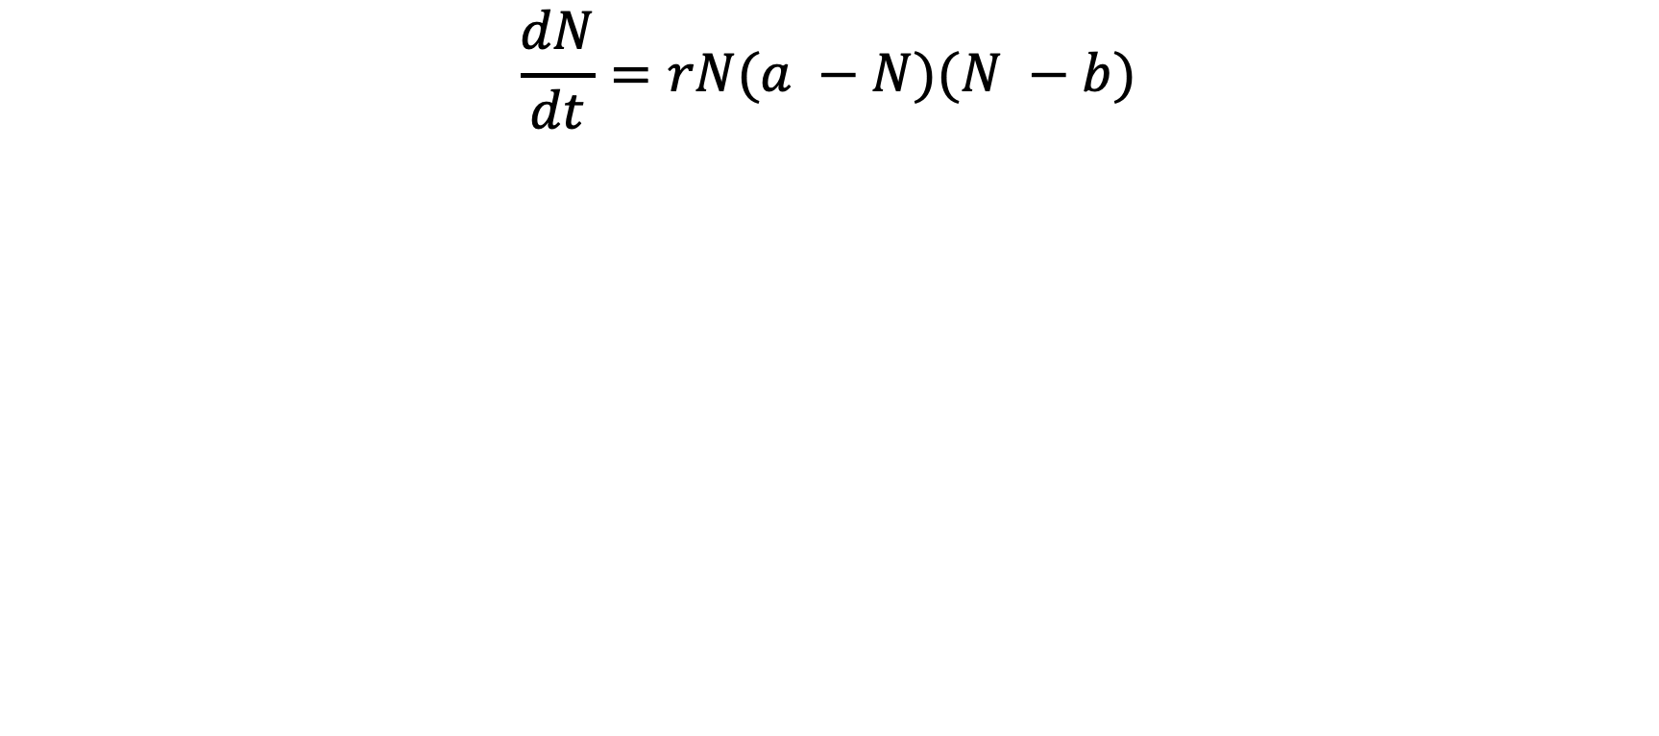
Solutions model 2: Allee effect
$$\frac{dN}{dt}=rN(a −N)(N −b)$$
If a<b
If a>b
If a = b

Slide 35
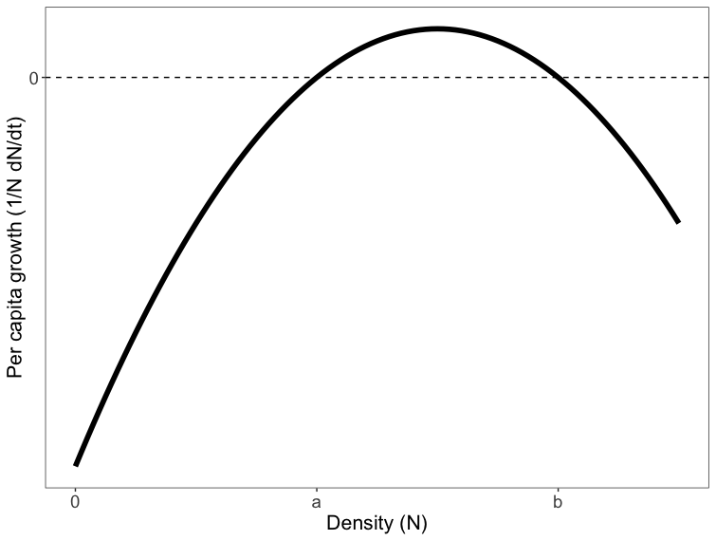
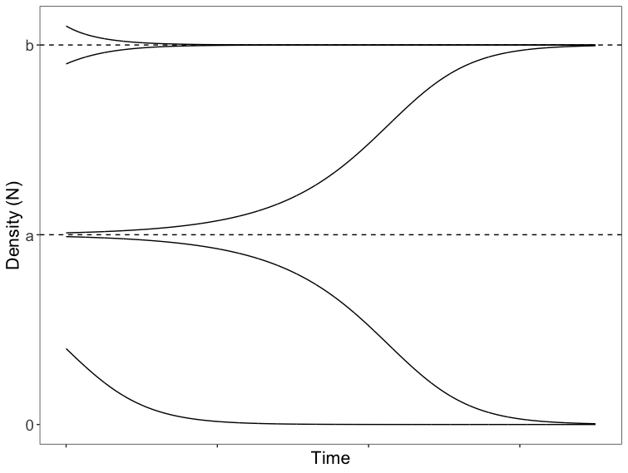
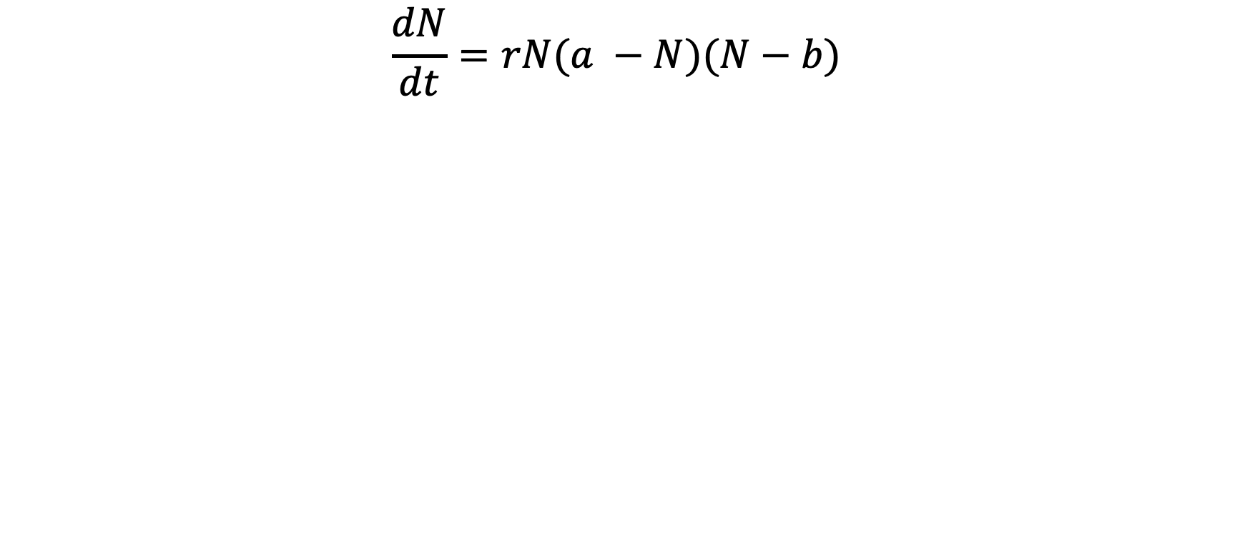
Solutions model 2: Allee effect
$$\frac{dN}{dt}=rN(a −N)(N−b)$$
Assuming a<b

Slide 36
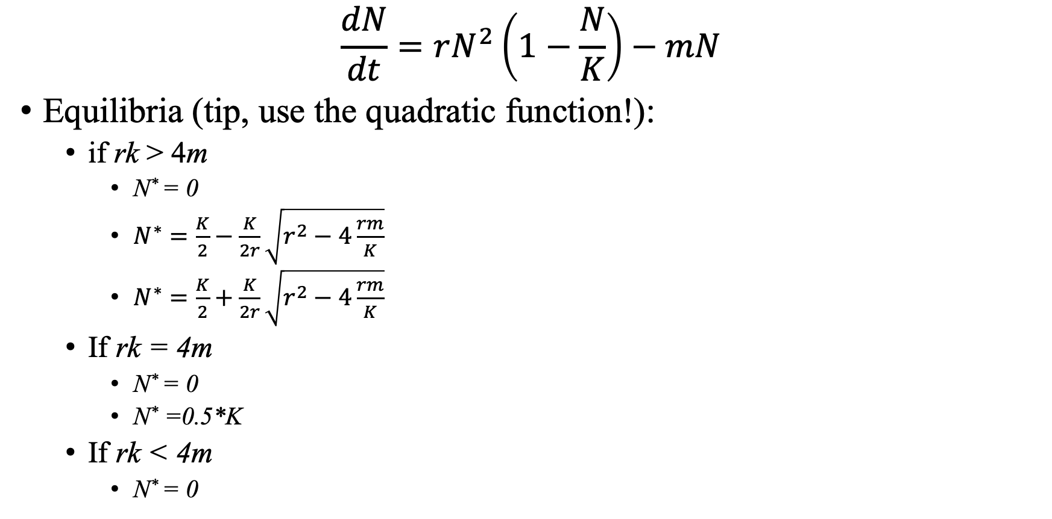
Solutions model 3: Allee effect
$$\frac{dN}{dt}=rN^{2}\left(1−\frac{N}{K}\right)−mN$$
Equilibria (tip, use the quadratic function!):
if rk > 4m
N* = 0
$N^{∗}=\frac{K}{2}−\frac{K}{2r}\sqrt{r^{2}−4\frac{rm}{K}}$
$N^{∗}=\frac{K}{2}+\frac{K}{2r}\sqrt{r^{2}−4\frac{rm}{K}}$
If rk = 4m
N* = 0
N* =0.5*K
If rk < 4m
N* = 0

Slide 37
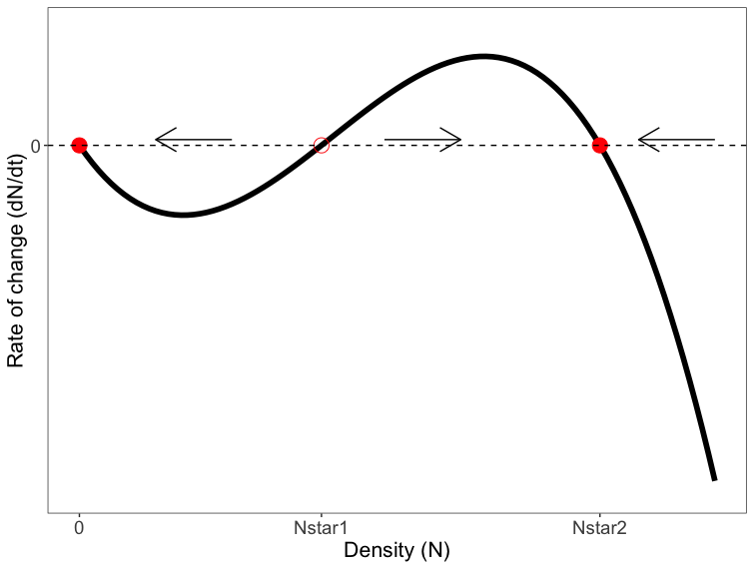
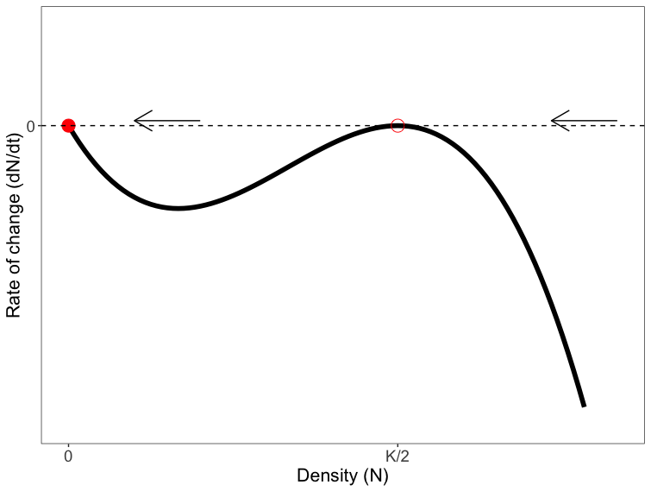


Solutions model 3: Allee effect
$$\frac{dN}{dt}=rN^{2}\left(1−\frac{N}{K}\right)−mN$$
If rk > 4m
If rk = 4m
If rk < 4m

Slide 38



Solutions model 3: Allee effect
$$\frac{dN}{dt}=rN^{2}\left(1−\frac{N}{K}\right)−mN$$
Nstar1 = $\frac{K}{2}−\frac{K}{2r}\sqrt{r^{2}−4\frac{rm}{K}}$
Nstar2 = $\frac{K}{2}+\frac{K}{2r}\sqrt{r^{2}−4\frac{rm}{K}}$
Assuming rk > 4m

